Slide 1
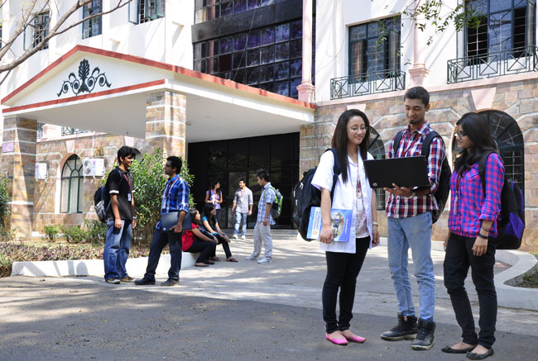

B.Tech Computer Science and Engineering – Vth Semester
Theory of Computation
Department of Computer Science and Engineering

Slide 2
What
Types of Grammar
Regular Grammar. (Regular Expressions) – regular Languages
Context Free Grammar – Context Free Languages
A->α
Context Sensitive Grammar - Context Sensitive Languages
1.aA->SaABc
2.aA->dac
Derivation: SaA->SaABc->Sdacc
α->β |α|< |β|
Unrestricted Grammar
α->β

Slide 3
Non Context Free Languages
L={a^{i}b^{i}c^{i} | i>=1}
Sample Strings of L={abc,aabbcc,aaabbbcc,……}
L={ a^{i}b^{j}c^{i} | j>I and i>=1}
Write a CFG for the language L={a^{i}b^{i}c^{i} | i>=1}
---------------------------
S->ABC
A->Aa|a
B->Bb|b
C->Cc|c
--------------------------
S->aSc
S->Sb|b
S->aSc->aaScc->aabcc

Slide 4
Suppose we have a parse tree according to the Chomsky Normal Form G=(V,T,P,S) ans suppose that the yield of the tree is w. if the length of the longest path is ‘n’ then|w|<=2^{n-1}
Basis Case:
n=1 . Recall that length of the path in trees is the number of edges between the root node and the leaf node.
ie one less than the number of nodes.
Hence a tree with max path length 1 is a root node with one leaf.
So |w| =1 since 2^{n-1}=2¹⁻¹=2⁰=1. Hence proved.

Slide 5
Proof….
Induction: if longest path is n and n>=1.
The root of the tree must use a production which is of the form A->BC since n>=1;
No path in the subtree rooted in the variables B and C can have a path length greater than n-1 because these paths excludes the edge from the root.
Hence by induction hypothesis these subtrees can have yield of length 2^{n-2} at most. The yield of the entire tree is the concatenation of both
Hence 2^{n-2} + 2^{n-2} =2^{n-1}

Slide 6
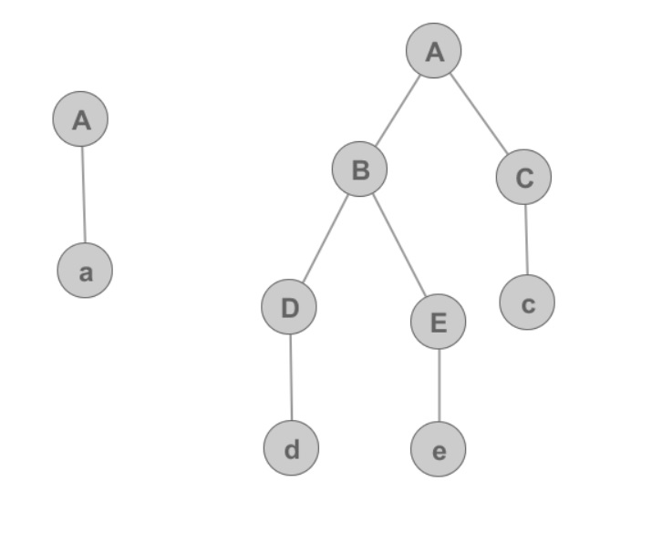
Proof….

Slide 7
Pumping Lemma of CFG
In a sufficiently long string in a CFL it is possible to find at most two short, nearby substrings that we can pump in tandem.
I.e we may pump both the strings ‘i’ times and the result will still be in the language.
Considering the language l={a^{n}b^{n}|n>=1}
In pumping lemma for RE we chose a string and pumped it any number of times and we have shown that the resultant string is still in the language(actually it should not be).
But if we do the same here by choosing some string of 0s and some string of 1s and pump them repeatedly we resultant string will have equal number of a’s and b’s only.

Slide 8
Statement of Pumping Lemma
Let L be a CFL ans ‘z’ is a string in L such that |z| is at least n.
Then we can write z=uvwxy subject to the following conditions
|vwx|<=n that is the middle portion is not too long
v x≠ε, Since v and x are pieces to be pumped it cannot be null.
For i>=0 uv^{i}wx^{i}y is in L. That is the two strings v and x may be pumped any number of times, including 0, and the resultant string will still be in L.

Slide 9
Statement of Pumping Lemma
L={a^{i}b^{i}c^{i}|i>=1} ….. i>=0 uv^{i}wx^{i}y
aaaabbbbcccc
aabbcc
aaaabaabbbbccbcccc
aaaabaabaabbbbccbccbcccc
aaaabaabaabaabbbbccbccbccbcccc
If we generalize the above case it will be uv^{i}wx^{i}y

Slide 10
Proving the pumping lemma
Our first step is to find Chomsky normal form Grammar G of the Language L. here L cannot be ε. Here we need not worry about empty strings .
Now starting with the CNF grammar G=(V,T,P,S) such that L(G) = L- ε and G has ‘m’ variables
Choose n=2^{m} here ‘n’ is the minimum length of the string ‘z’.
Then as per the theorem a path of length m must have the yield of 2^{m-1} which is n/2 or less.
Such a parse tree cannot yield Z .

Slide 11
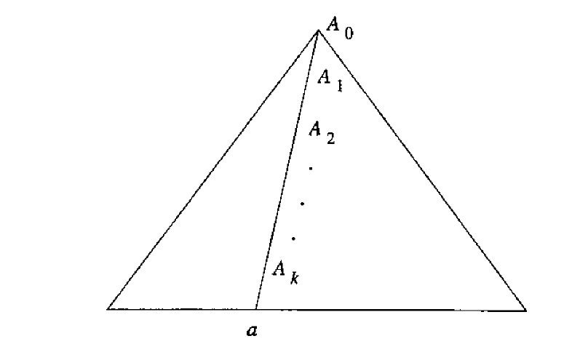
Non Context Free Languages
we need a longer parse tree with path length of m+1.

Slide 12
Proof of pumping lemma of CFG
Suggests a tree for z, where K is at least m and the path is of length k+1.
Since k>=m then there will be atleast m+1 occurrences of variable A₀ A₁ ….A_{k} on the path.
As there are only m variables but we see K variables in the path there mush be atleast one repeated variable in the path such that A_{i} =A_{j}
where k-m<=i<=j<=k.

Slide 13
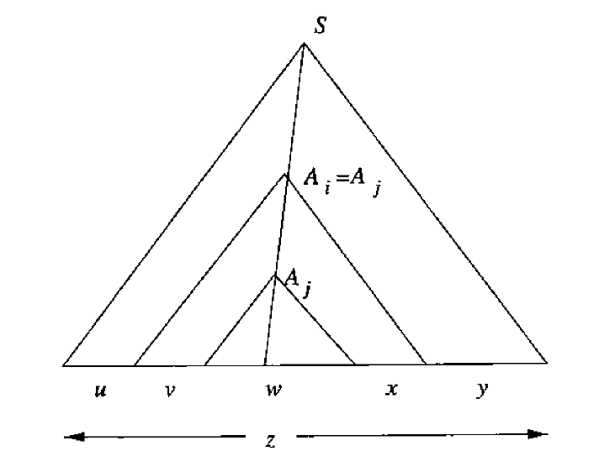
Then it is possible to divide the tree as shown in the figure.

Slide 14
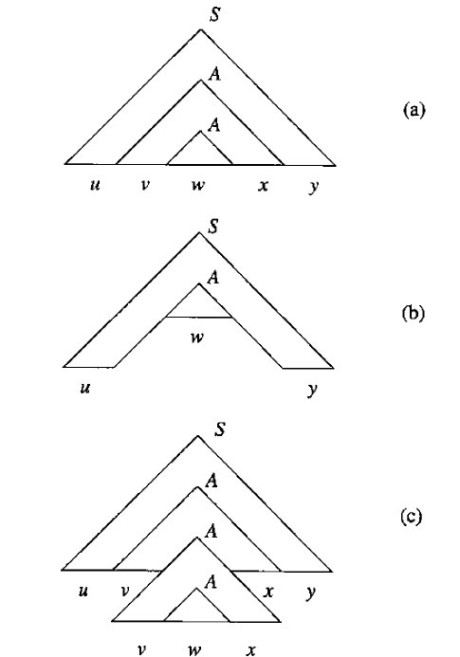
Non Context Free Languages

